Slide 1
Capstone Presentation Mahindra First Choice Services, Case Study
Completed by: Team 3
Aparna Singh
Sammek Ovhal
Krishna Das
Sourabh Choudhary

Slide 2
Introduction
Mahindra First Choice Services (MFCS)- Leading Automobile Brand in the country
335+ workshops in 267+ towns & 24 states
Serviced over 10,50,000 car
400 workshops by March 2018.
Data Dating: 2012-2016
Data dimension: ​534000 Customer entries

Slide 3
Objective: Geolocation Based Customer Analysis
Primary Objective:
Identifying the ownership pattern of cars throughout the country.
Expected Business Outcome​:
Better Marketing Campaigns.
Understand Spending patterns

Slide 4
Secondary Objective
​Identify the type of order each state receives
Expected Business Outcome
Helps Mahindra to tackle Seasonal issues much efficiently.

Slide 5
Tertiary Objective
Customer Lifetime value prediction
Based on Customer segments, predict the revenue that can be extracted from each segment over a life of the car -Regression/Time Series with Market Segmentation

Slide 6
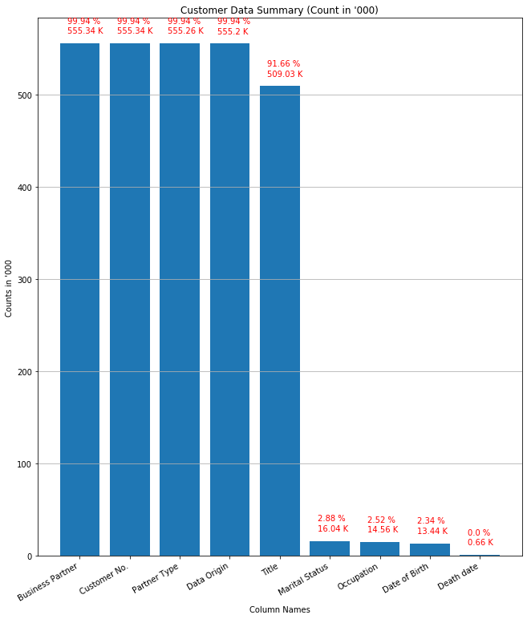
Customer Data Summary

Slide 7
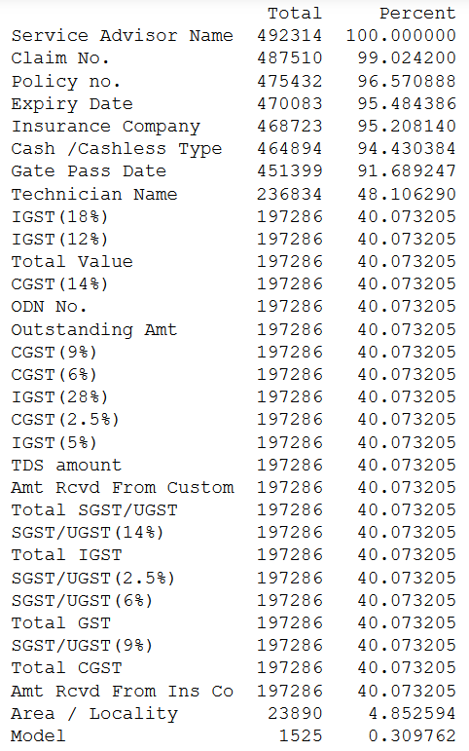
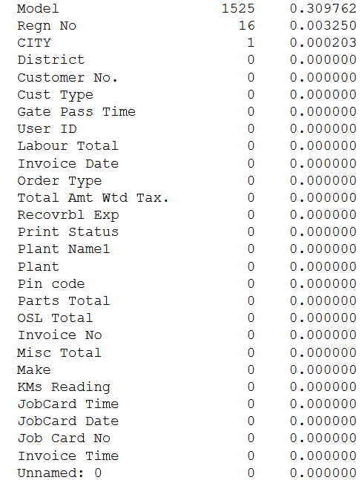
Invoice Data Summary

Slide 8
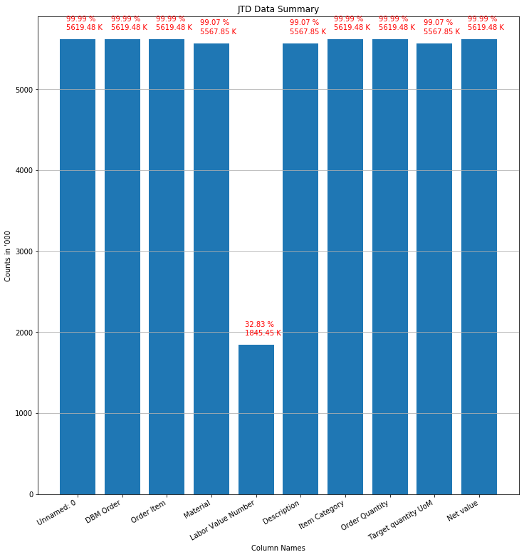
JTD Data Summary

Slide 9
Data Preprocessing
Data Slicing: Customer Type and Total amount without Tax
Removed Trailing zero
Fill na
Basic Feature Selection (Removed Columns with less Data)
Data Merging

Slide 10
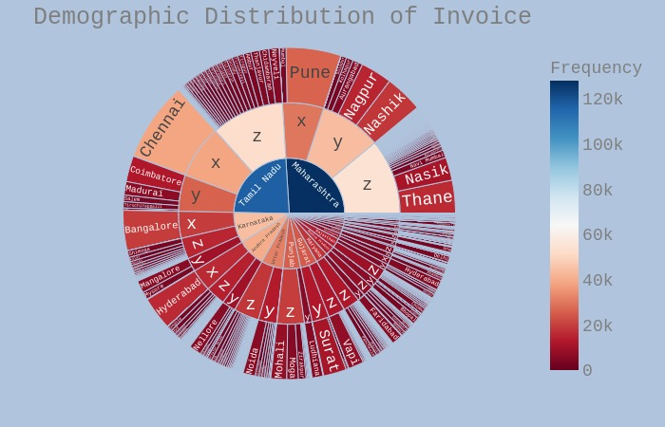
Primary Objective: Ownership and Spending patterns
Tier wise distribution of states
5 Major Demanding cities- Chennai, Pune, Nagpur, Nashik, Thane.
State wise Tamil Nadu and Maharashtra are filled with opportunity for New Plants establishment.

Slide 11
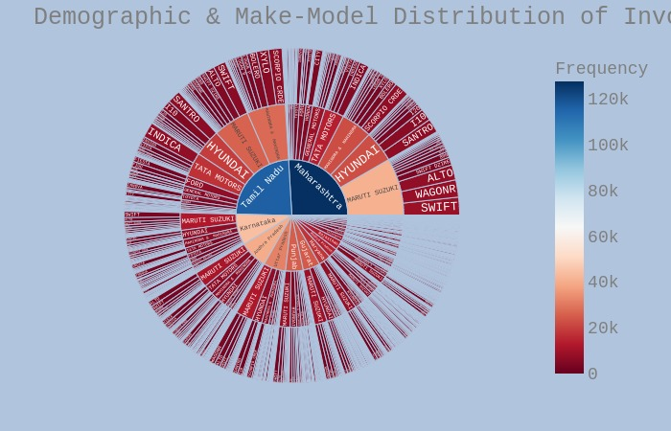
Demographic & Make-Model Distribution
What we can Infer from this graph is that Percentage share of Maruti Suzuki is highest in Tamil Nadu and Maharashtra

Slide 12
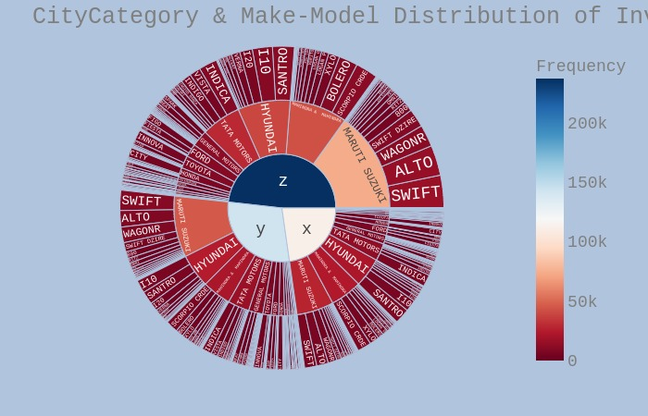
City Category and Make-model Distribution
Tier wise Distribution of Cities for Make model of cars :
X= Tire 1
Y= Tire 2
Z= Tire 3

Slide 13
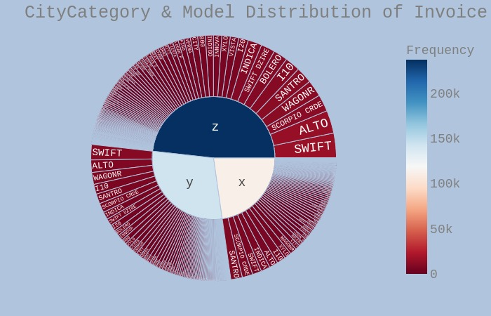
City Category & Model Distribution
Santro, Scorpio CRDE, Swift CRDE are the 3 top models having the highest % share in tier 1 cities respectively.
Swift, Alto, WagonR are the 3 top models having the highest % share in tier 2 cities respectively.
Maruti swift, Alto, Scorpio CRDE are the 3 top models having the highest % share in tier 3 cities respectively.

Slide 14
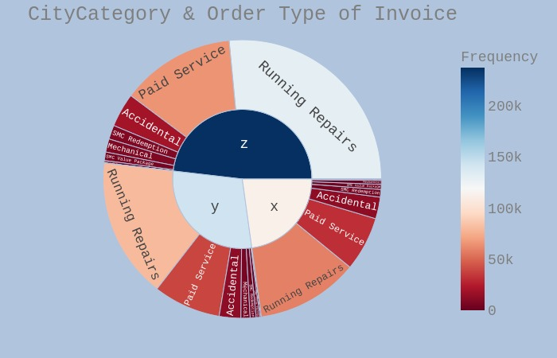
City Category & Order Type
Tier 1, Tire 2, Tire 3 cities have the highest % share of Running Repairs Followed by Paid Services, Accidental and so on.

Slide 15
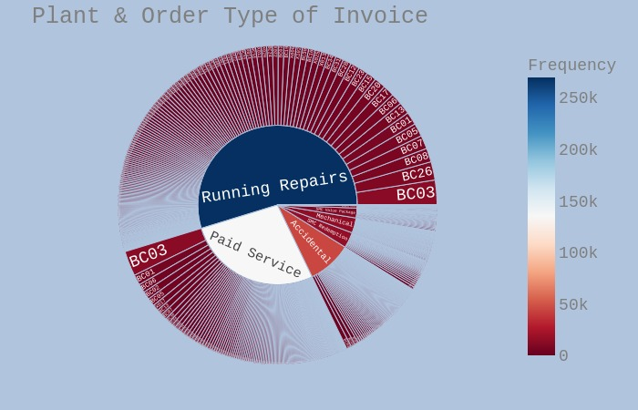
Plant & Order Type
BC03 is the most active plant followed by BC26, BC08 for all types of Orders

Slide 16
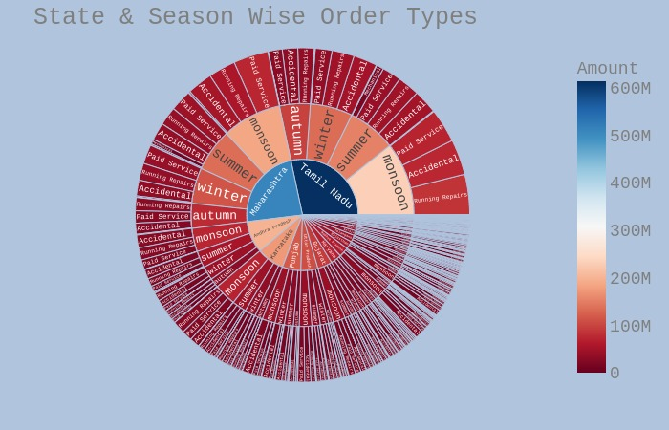
State, Season, Order Wise Revenue
What we observe based on our analysis is that in “Monsoon” is the optimum season For increasing the business as most of the Repair orders are high across all cities in India.

Slide 17
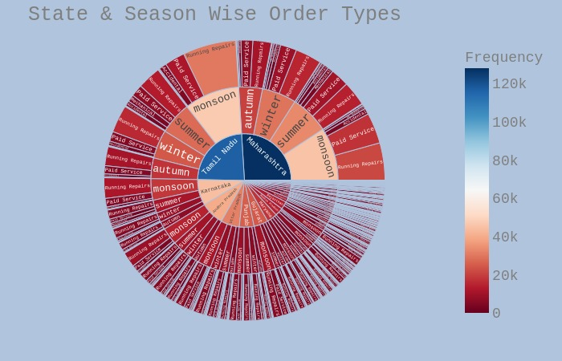
State, Season, Order Wise by Count
Distribution of Maximum type of Repair orders by their counts across different seasons and states.

Slide 18
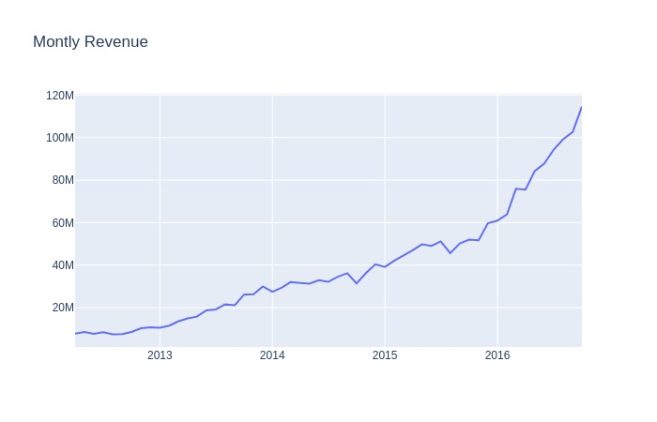
Time plot of Monthly Revenue Generation

Slide 19
Market Segmentation
Feature Engineering
One Hot Encoding
Principal Component Analysis (PCA)
Using “K means” generated 10 Clusters

Slide 20
Market Segmentation Approach
RFM Score Calculations
RECENCY (R): Days since last purchase
FREQUENCY (F): Total number of purchases
MONETARY VALUE (M): Total money this customer spent

Slide 21
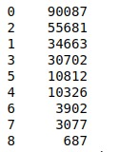
RFM Calculation Recency, Frequency and Revenue
The lowest recency, highest frequency and monetary amounts are our best customers.

Slide 22
Predicting our Customer Cluster – Decision Tree F1 Score: 0.984
Model | Score
Linear Regression | 0.9068
Logistic Regression | 0.11
Decision Tree | 0.984
Random Forest Classifier | 0.818
ADABoost | 0.83

Slide 23
Customer LTV - Using Decision Tree F1 Score: 0.7979
Model | Score
Logistic Regression | 0.4846
Decision Tree | 0.7979
Random Forest Classifier | 0.1240
ADABoost | 0.2300

Slide 24
Insights
Based on our Analysis, Suzuki Tops the list and is the “Cash-Cow” Product for Mahindra.
Ideal Opportunity in Metro cities for New plants establishment.
Heavy Frequency in Monsoon season
Improve focus on Proper Data collection
Attract more HNI customers

Slide 25
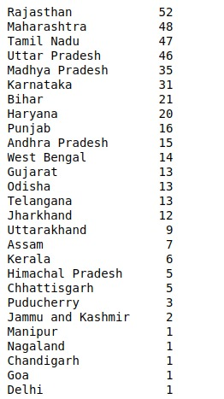
State Wise Plant Count

Slide 26
References:
https://towardsdatascience.com/tagged/data-driven-growth
https://towardsdatascience.com/data-driven-growth-with-python-part-3-customer-lifetime-value-prediction-6017802f2e0f
https://towardsdatascience.com/data-driven-growth-with-python-part-2-customer-segmentation-5c019d150444

Slide 27
Thankyou !!

